Slide 1

Financial Disclosure for:
Interactive Invited Workshop:
Open Targets: Using Genetics and Functional Genomics to
Identify and Prioritize Targets for New Medicines
Nothing to Disclose:
Maya Ghoussaini
Edward Mountjoy
Ellen Schmidt
Daniel Wright

Slide 2

Workshop Wi-Fi
Select the SSID: ASHGWORKSHOP
Enter password: ASHGWORKSHOP
Password is case-sensitive

Slide 3



Open Targets: Using Genetics and Functional Genomics to Identify and Prioritize Targets for New Medicines
ASHG Invited Workshop
Thursday, October 18, 2018, 7:15 - 8:45 AM
Maya Ghoussaini, Edward Mountjoy, Ellen Schmidt, Daniel Wright

Slide 4
Agenda for today’s workshop
What is Open Targets?
Introducing: Open Targets Genetics
Demo
Interactive Exercises (30 min)
Demonstrate the role of genetics supporting an existing drug
Demonstrate a known drug repurposing opportunity
Exercise review and questions
Notes:
These are the points we will cover today. I’ll give you a bit of background about Open Targets as a consortium, it
We will then move to OT genetics, talk about the data that feeds into it, its functionality and features it offers, the workflow,
Ed will show you a demo which will
We will be moving around the room to answer questions
Dan and Ellen will go through the answers
By the end of the session we hope that you’ll be able to navigate through the portal and answer your biological questions. to explore your phenotypes of interest and biological questions

Slide 5

High failure rates in drug discovery
> 85% of candidate drugs that enter clinical trials fail
Majority fails at later stages
Genetics increase chances of success (Nelson MR et al., Nat Genet. 2015)
Drug is 10x more likely to succeed if target identified in Mendelian genetic evidence
Drug is 2x more likely to succeed if target is supported by GWAS evidence
Notes:
Drug development is a lengthy, complex, and costly process
Or Druf development is a long and expensive process
It can take 10 to 15 years to make a drug
Failure at later stages because of lack of efficacy so no therapeutic benefit for the patient.
So how we can pick better targets?
A study conducted by GSK showed that genetically supported drug targets are more likely to succeed.
How can we choose better targets

Slide 6
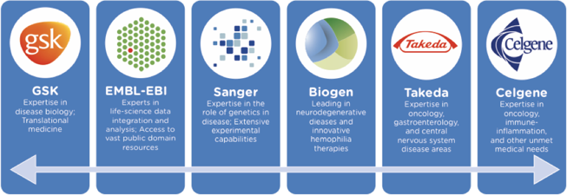
To transform drug discovery through the systematic identification and prioritization of targets
Open Targets Vision
Notes:
Bringing the expertise from basic science and drug discovery together

Slide 7

How can genetics and genomics be used to guide therapeutic target identification and prioritization?
Released today!
Notes:
Pink color

Slide 8


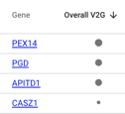


Unique features in Open Targets Genetics
Find shared susceptibility loci
Fine-mapping across UK Biobank phenotypes
Prioritize genes using an integrated functional score
Connect genes with known drugs in Open Targets platform
Visualize associations between traits, variants, and genes

Slide 9
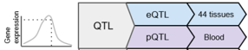
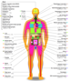


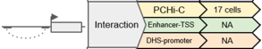
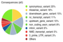
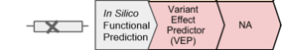
Data feeding into Open Targets Genetics
Human Genetics (Complex traits)
Variant – Disease
Functional Genomics
Variant – Gene
Curation of published
GWAS loci
Full summary statistics
Neale and colleagues v1
337,199 individuals
2,419 traits
Annalisa Buniello’s talk
Session #101,
Saturday, Oct 20 @ 10:30am
Room 6A, Upper Level
Notes:
Two types of data feed into the platform : human genetics and functional genomics

Slide 10
Data model for Open Targets Genetics
r²
Posterior Prob.
S
P-value
V_{L}
V_{T}
Aggregated score
G
GWAS Catalog
UK Biobank
Fine mapping
LD expansion
eQTL (GTEx V7)
pQTL
PCHI-C
FANTOM5
VEP
S: Study
V_{L}: Lead variant
V_{T}: Tag variant
G: Gene
Notes:
We used 1000 genomes for LD expansion
UK10K for fine-mapping

Slide 11
Workflow of Open Targets Genetics
V
S
G
Variant
Trait
Gene
Genes functionally implicated
Variant association across traits (PheWAS)
Variants tagged
Independently associated loci
Overlapping susceptibility loci
Associated traits
Links to drugs, expression, pathway and mouse phenotype data in Open Targets Platform
Locus View plot
Visualizing the associations between traits, variants, and genes
Fine mapping analysis
Notes:
Visualization focused on a region
Portal user entry points
So when you come to the site, there is a search box, you could search for a gene, trait/diseases, and variants. I’m just gonna pick an example gene which is CDK6. What’s come up is a quite complicated diagram which we’d like to simplify in the future.
working with Neale et al.’s UK Biobank summary statistics (2419 traits)
. Initially, the portal will provide a visualisation that integrates the association between disease and genetic variation, from GWAS data, with variant-to-gene assignments, through the aggregation of cis-regulatory functional data (e.g. eQTLs, promoter-capture HiC, Fantom5). Where full summary statistics are available from the GWAS Catalog, the variant-disease associations will be derived from genome-wide conditional analysis to identify independent loci, followed by fine mapping to identify the most likely causal variants at each locus.

Slide 12
Demo: Open Targets Genetics
https://genetics.opentargets.org/
Notes:
Mention table filters
If there is no search on Compare studies page, tell them that you can Ctrl + F
On locus explanation, make very clear where links come from
Trait search, search by full name
- At end: Show them how to find the docs.

Slide 13
Variant-to-Gene Assignment
Data type
Source
Feature
(tissue/cell)
V₁G₁ … … … V_{M}G_{N}
Weighted by source
QTL
eQTL
44 tissues
×0.6
Gene expression
pQTL
Blood
×0.6
PCHi-C
17 cells
×0.3
Interaction
Enhancer-TSS
NA
×0.3
DHS-promoter
NA
In Silico
Functional
Prediction
Variant Effect
Predictor (VEP)
NA
×0.3
×1.0
Quantile
transformation
(within feature)
Variant-Gene
annotation
Aggregate across features
(max score)
Aggregate across sources
(mean weighted-score)
Notes:
Make it clear that anything with a none-zero score is “significant”
Colocalisation will be added
Currently all functional data is used to calculate aggregated scores, we want to get to a place where you can set up a configuration which allows functional datasets specific to your therapeutic area of interest to be calculated

Slide 14
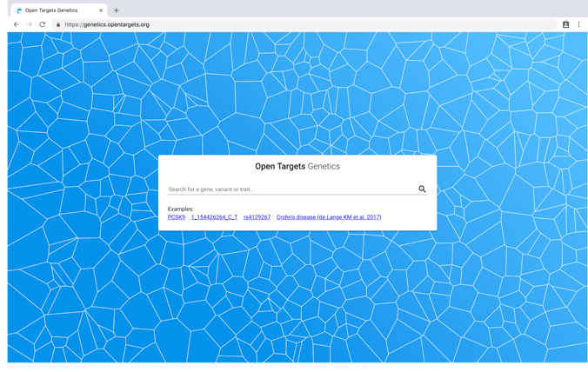
Home page

Slide 15
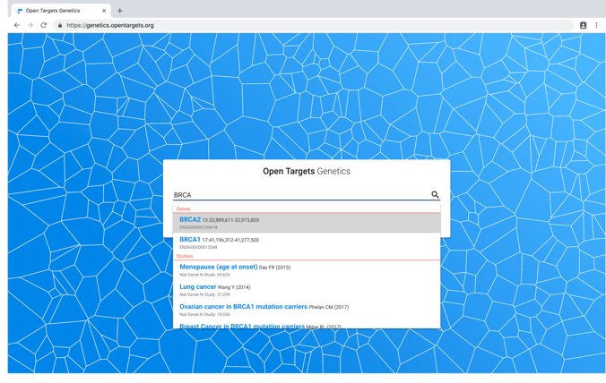
Home page - search by gene

Slide 16
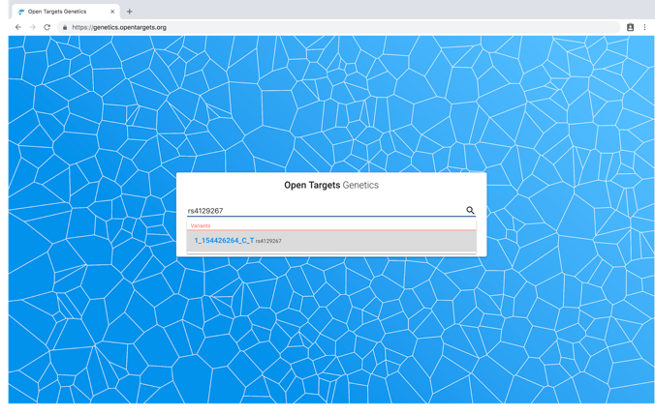
Home page - search by variant

Slide 17
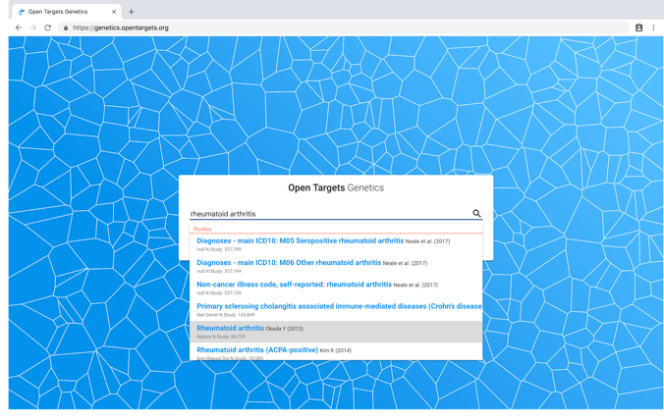
Home page - search by trait
Notes:
We are actually selecting a study
Sorted by sample size

Slide 18
Home page - search by trait
Notes:
We are actually selecting a study
Sorted by sample size

Slide 19
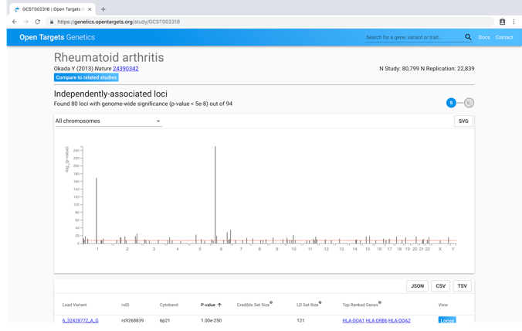
Study page - Manhattan-like view

Slide 20
Study page - Manhattan-like view

Slide 21
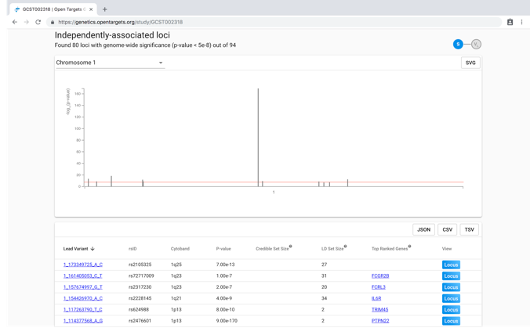
Study page - Chromosome zoom
Notes:
LD set size
Credible set size
Top ranked genes

Slide 22
Study page - Chromosome zoom

Slide 23
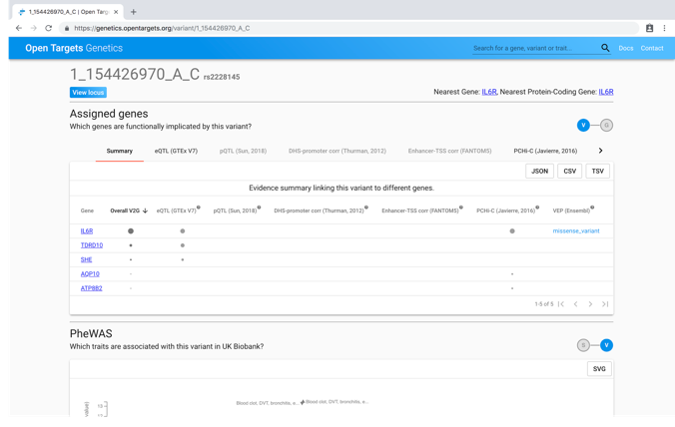
Variant page - Assigned genes

Slide 24
Variant page - Assigned genes

Slide 25
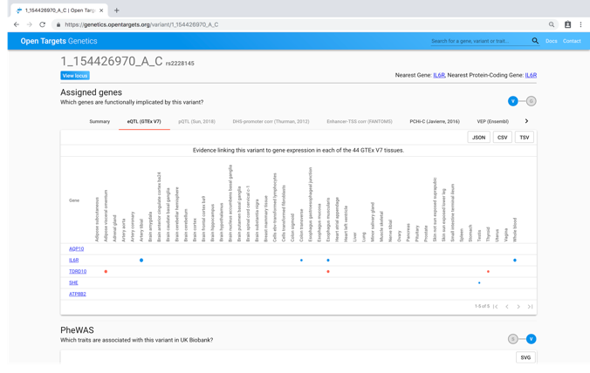
Variant page - Assigned genes (eQTL tab)

Slide 26
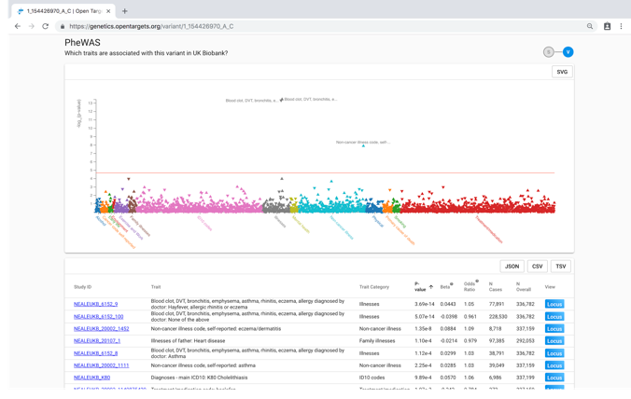
Variant page - PheWAS

Slide 27
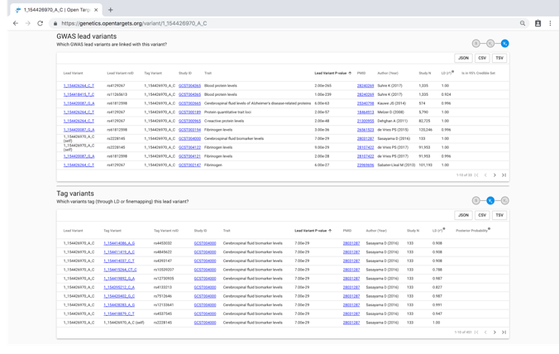
Variant page - Lead and tag-variant tables

Slide 28
Variant page - Select gene

Slide 29
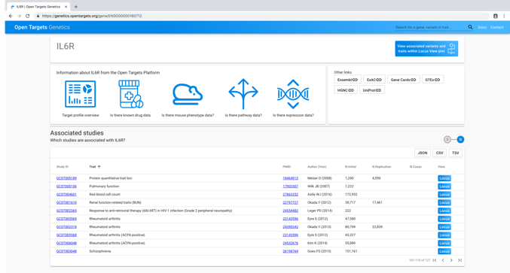
Gene page

Slide 30
Gene page

Slide 31
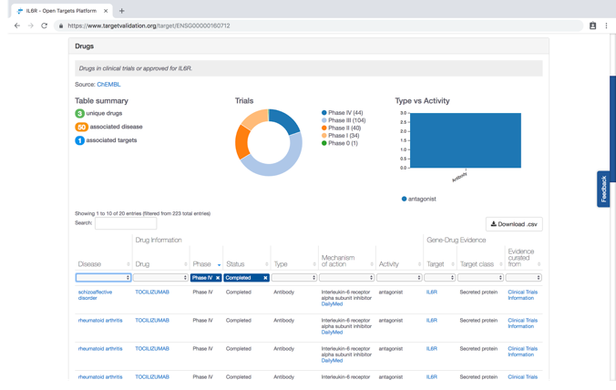
Drug information (Target Validation Platform)

Slide 32
Variant Page –Link to Locus View

Slide 33
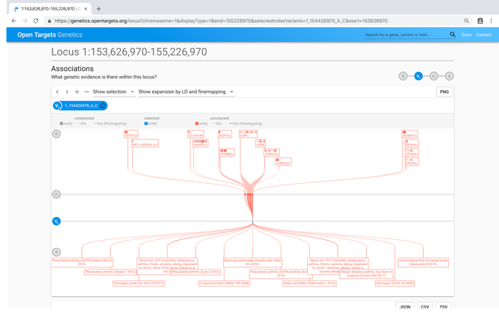
Locus View

Slide 34
Locus View - Select gene entity

Slide 35
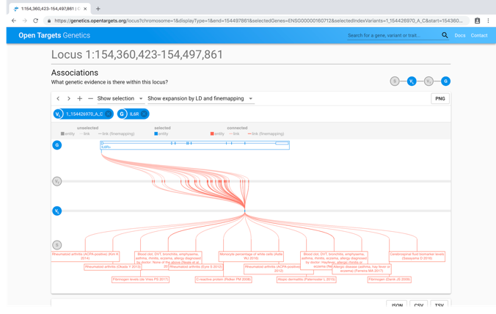
Locus View - Select gene entity

Slide 36
Locus View - Select study entity

Slide 37
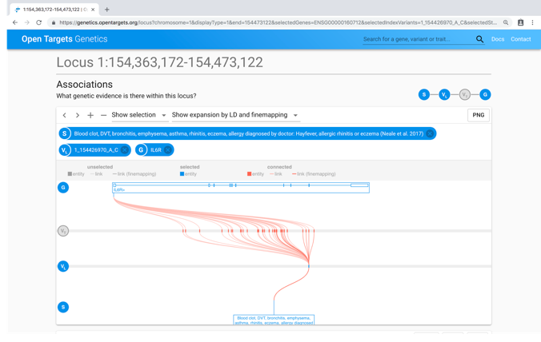
Locus View - Add study entity
Notes:
Difficult to distinguish LD from fine-mapping

Slide 38
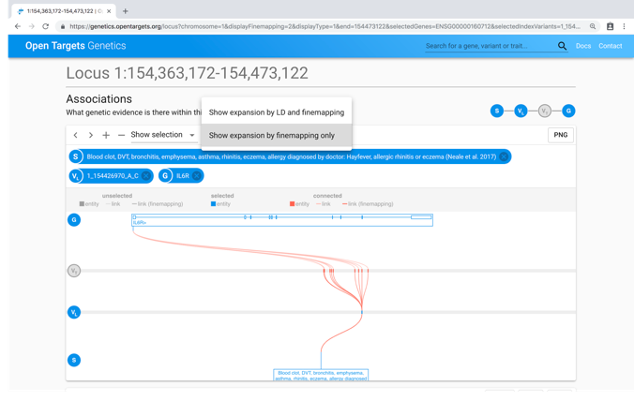
Locus View - Show fine-mapping only

Slide 39
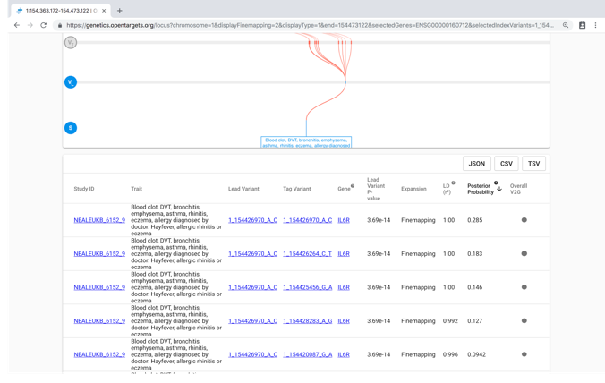
Locus View - Table shows additional information

Slide 40
Locus View – How to find overlapping loci for specific diseases?

Slide 41
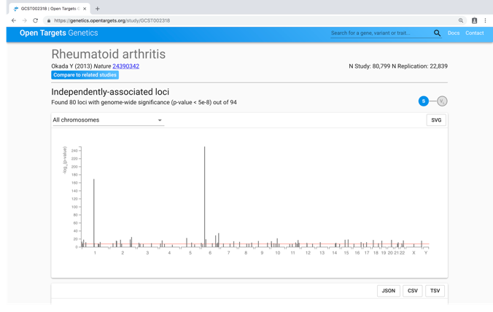
Study Page - Compare Studies button

Slide 42
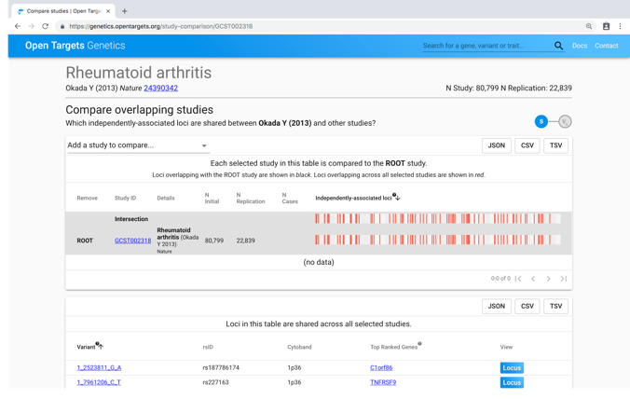
Compare Studies Page

Slide 43
Compare Studies Page - Add studies

Slide 44
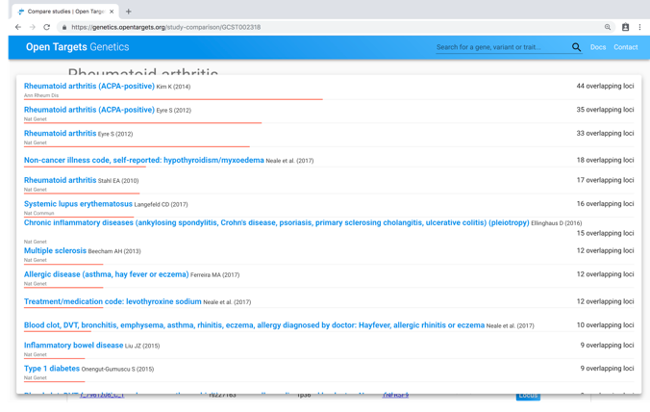
Compare Studies Page - Add studies

Slide 45
Compare Studies Page - Add studies

Slide 46
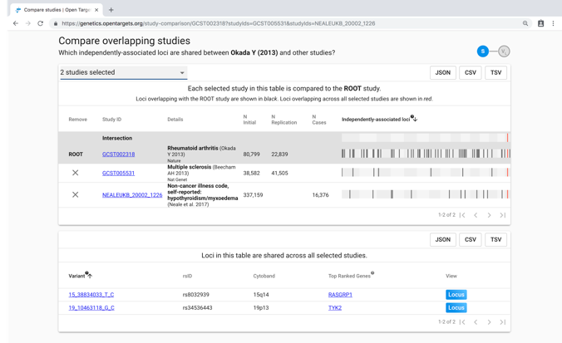
Compare Studies Page - Shared loci

Slide 47
Compare Studies Page - Go to Locus View
Notes:
Remake

Slide 48
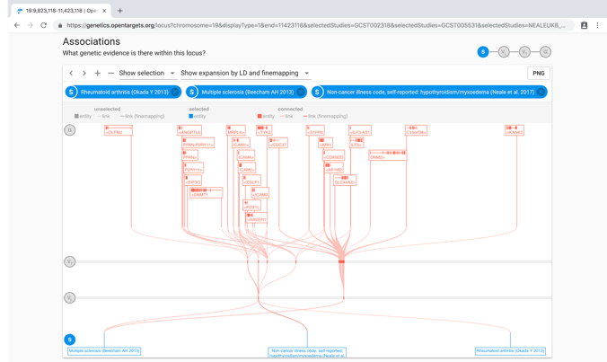
Locus View - With 3 studies selected

Slide 49
Gold Standard Analysis
Gold-standard dataset
Manually-curated set of associations with strong experimental functional data linking variant with gene
17 premium gold-standard associations
Range of diseases including: breast cancer, prostate cancer, T2D diabetes, Parkinson’s, coronary artery disease, blood lipid levels
Variant-to-gene assignment using Open Targets Genetics (v1):
Out of 17 premium gold standards, we find 1+ of the target genes for 14 (82% hit rate)
Out of a total of 26 target genes (some examples have more than 1), we find 17 target genes (65%)
Restricting to blood-related traits only, we find 7/7 target genes (100%)

Slide 50
Exercises: Open Targets Genetics
Exercises: https://genetics-docs.opentargets.org/ashg-workshop-2018
Portal: genetics.opentargets.org
Exercise 1: Demonstrating the role of genetics supporting an existing drug
Exercise 2: Demonstrating a drug repurposing opportunity
Notes:
Add URL to PDF

Slide 51
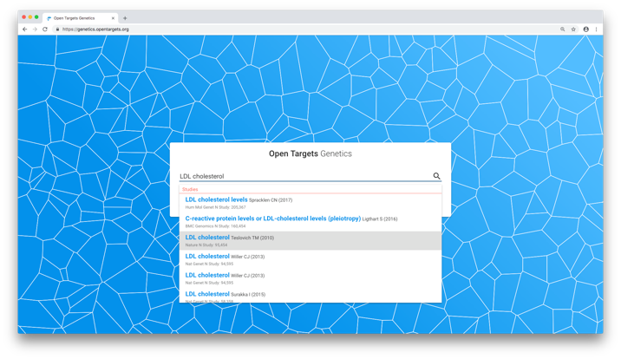
Exercise 1: Using Open Targets to retrospectively demonstrate the role of genetics supporting an existing drug

Slide 52
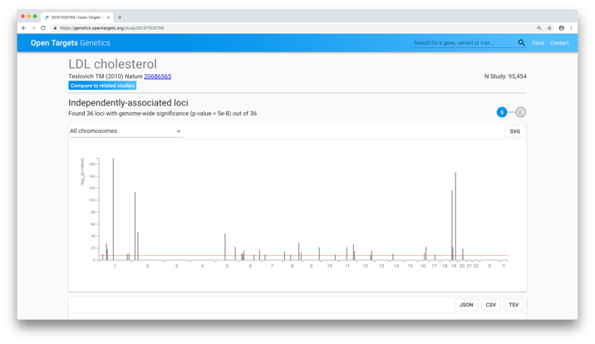
Exercise 1: Using Open Targets to retrospectively demonstrate the role of genetics supporting an existing drug

Slide 53
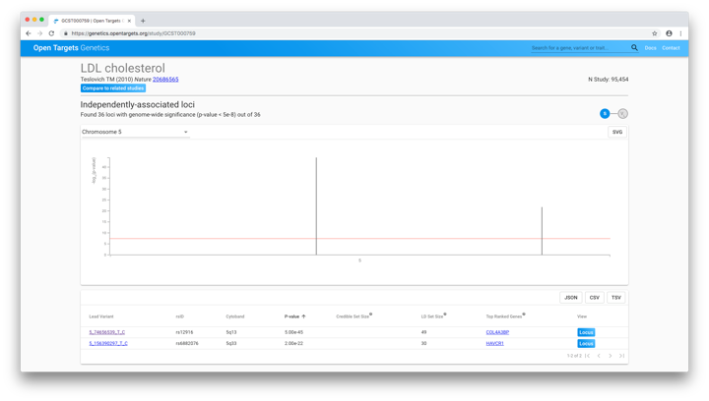
Exercise 1: Using Open Targets to retrospectively demonstrate the role of genetics supporting an existing drug

Slide 54
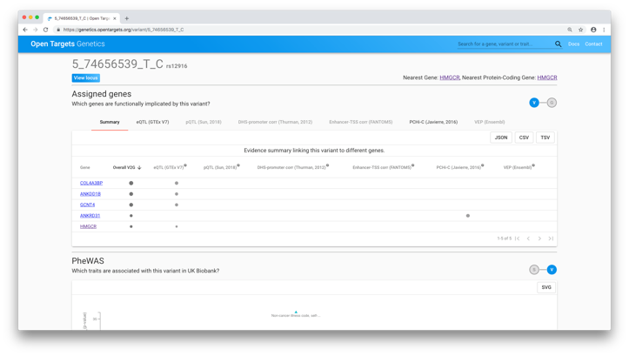
Exercise 1: Using Open Targets to retrospectively demonstrate the role of genetics supporting an existing drug

Slide 55
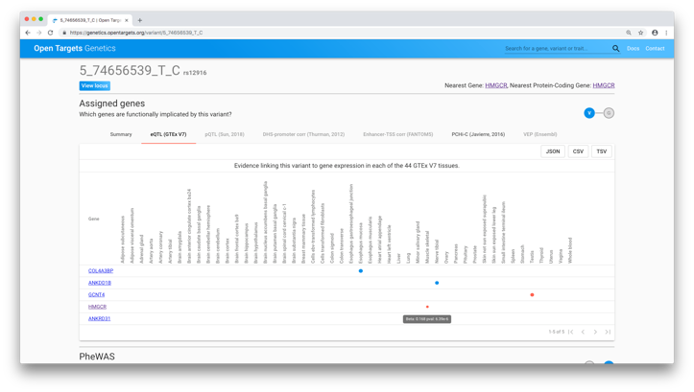
Exercise 1: Using Open Targets to retrospectively demonstrate the role of genetics supporting an existing drug

Slide 56
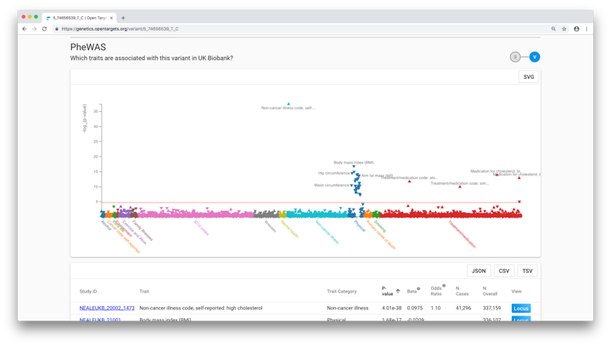
Exercise 1: Using Open Targets to retrospectively demonstrate the role of genetics supporting an existing drug

Slide 57
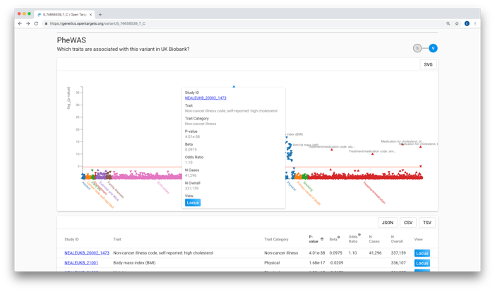
Exercise 1: Using Open Targets to retrospectively demonstrate the role of genetics supporting an existing drug

Slide 58
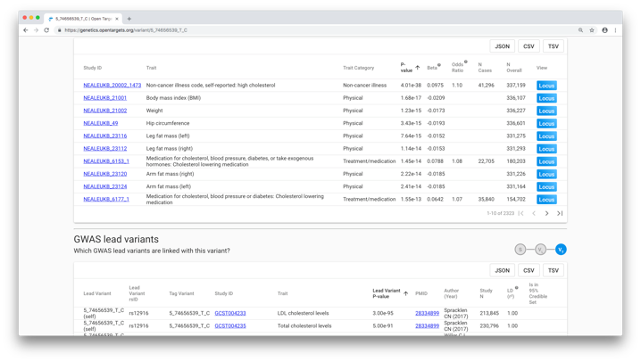
Exercise 1: Using Open Targets to retrospectively demonstrate the role of genetics supporting an existing drug

Slide 59
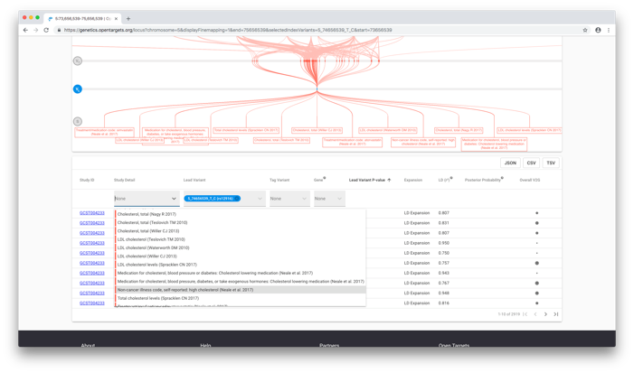
Exercise 1: Using Open Targets to retrospectively demonstrate the role of genetics supporting an existing drug

Slide 60
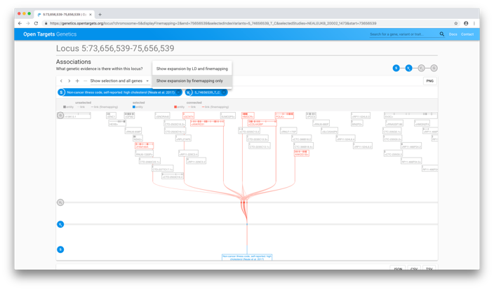
Exercise 1: Using Open Targets to retrospectively demonstrate the role of genetics supporting an existing drug

Slide 61
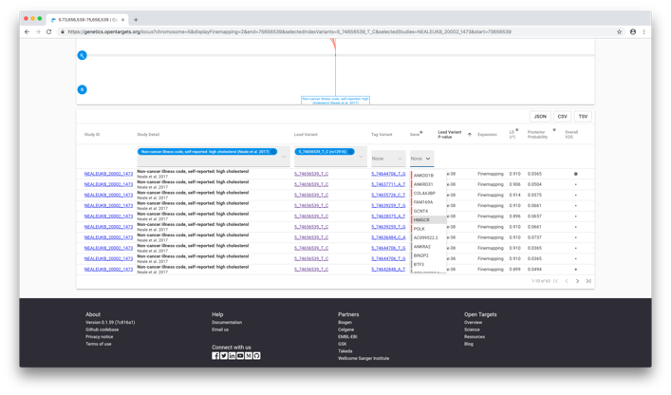
Exercise 1: Using Open Targets to retrospectively demonstrate the role of genetics supporting an existing drug

Slide 62
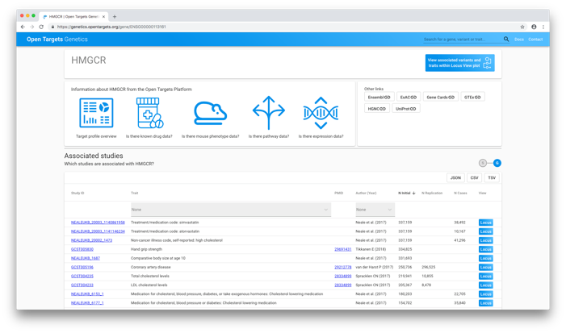
Exercise 1: Using Open Targets to retrospectively demonstrate the role of genetics supporting an existing drug

Slide 63
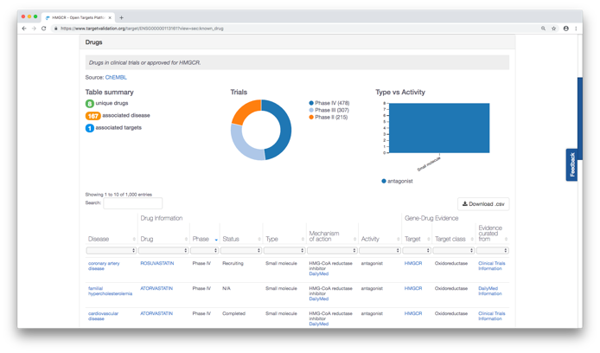
Exercise 1: Using Open Targets to retrospectively demonstrate the role of genetics supporting an existing drug
Notes:
Statins inhibit hydroxy-3-methylglutaryl coenzyme A reductase (the protein product of HMGCR) and thereby reduce LDL-C and TC levels.

Slide 64

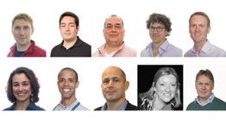
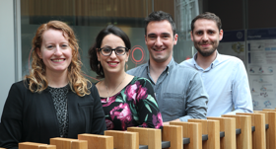





Contact us:
geneticsportal@opentargets.org
https://genetics.opentargets.org/
@targetvalidate
Core Platform team
Core Genetics team
POSTGAP team
GWAS Catalog team
Feedback survey:
http://bit.ly/ot-ashg-survey

